Slide 1
Regional Economic Integration
Dr. Kwangsoo Kim
Konkuk University

Slide 2
AGENDA
Concept of Economic Integration
Economic and Political Arguments for REI
Examples of REI
Implications for Businesses

Slide 3
COMPONENTS OF GLOBAL BUSINESS ENVIRONMENT
World/General
Country/General
Trade
FDI
Economic
Market/Industry
Demographic
Competitors
Technologies
Customers
Suppliers
Social
Firm
Legal
Creditors
Labor union
Distributors
Stock holders
Regional
EI
Foreign
Exchange
Political
Technological
International
Institutions

Slide 4
Concept of
Economic Integration

Slide 5
Economic Integration
Agreements between/among countries to reduce and ultimately remove tariff and non-tariff barriers to the free flow of goods, services, and factors of production between member countries
In theory, economic integration benefits all members.
Over the last two decades, the number of bilateral / regional trade agreements has been on the rise

Slide 6
Economic Integration
Three levels of economic integration
- Global: trade liberalization worldwide by WTO
- Regional: preferential treatment of member countries in the region/group
- Bilateral: preferential treatment between two countries
Regional and bilateral agreements are against the MFN clause but allowed under WTO.
Visit www.wto.org for regional trade agreements

Slide 7
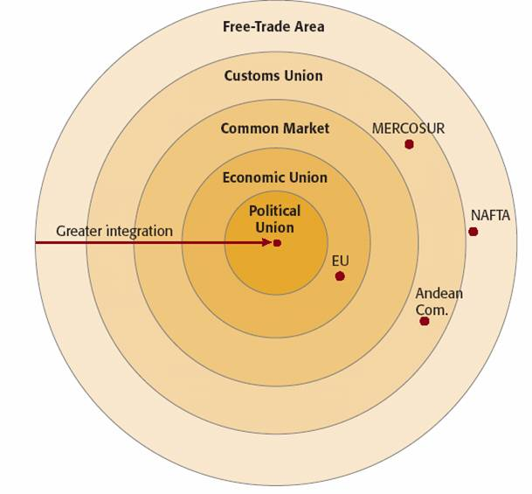
Types of Regional Economic Integration

Slide 8
Types of Regional Economic Integration
No trade Common Free flow Common Common barriers: external of labor & monetary & political
members trade policies capital fiscal policy systems
Free Trade O X X X X
Area
Customs O O X X X
Union
Common O O O X X
Market
Economic O O O O X
Union
Political O O O O O
Union

Slide 9
Types of Regional Economic Integration
Free trade area:
- North American Free Trade Agreement (NAFTA)/USMCA
Customs union:
- Andean Pact (Bolivia, Columbia, Ecuador & Peru)
Common market:
- Old European Union(EEC/EC)
Economic union:
- Current European Union
Political union:
- USA

Slide 10
Economic and Political Arguments for
Regional Economic Integration

Slide 11
Economic Arguments for Regional Economic Integration
Regional economic integration is an attempt to achieve additional gains from the free flow of trade and investment between countries beyond those attainable under international agreements such as the WTO
Since it is easier to form an agreement with a few countries than across all nations, there has been a push toward regional economic integration

Slide 12
Political Arguments for Regional Economic Integration
Politically, integration is attractive because
- by linking countries together, making them more dependent on each other, and forming a structure where they regularly have to interact, the likelihood of violent conflict and war will decrease
- by linking countries together, they have greater clout and are politically much stronger in dealing with other nations

Slide 13
Case against Regional Economic Integration
Regional economic integration makes sense only when the amount of trade it creates exceeds the amount it diverts (trade creation > trade diversion)
Trade creation occurs when low cost producers within the free trade area replace high cost domestic producers
Trade diversion occurs when higher cost suppliers within the free trade area replace lower cost external suppliers

Slide 14
Regionalization vs. Globalization
While regional trade agreements are designed to promote free trade, there is some concern that the world is moving toward a situation in which a number of regional economic blocks compete against each other.
If this scenario materializes, the gains from free trade within blocs could be offset by a decline in trade between blocs
Is this scenario plausible?
Does regionalization facilitate or hamper globalization?

Slide 15
Examples of
Regional Economic Integration

Slide 16
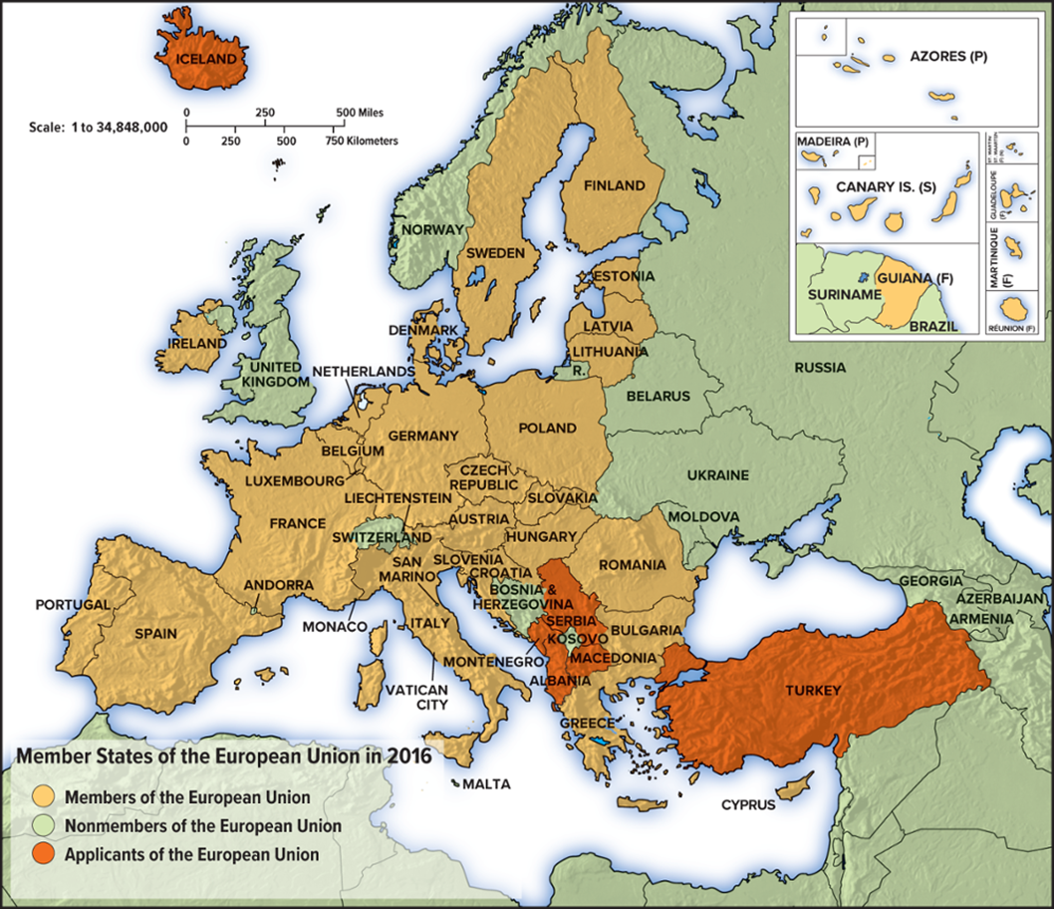
Regional Economic Integration in Europe: European Union (EU)

Slide 17
EU Formation
The European Union (EU) is the result of:
- the devastation of two world wars on Western
Europe and the desire for a lasting peace
- the desire by the European nations to have a greater
influence on the world’s political and economic areas
1951: Treaty of Paris - European Coal and Steel Community (6)
1957: Treaty of Rome – European Economic Community (which
became EC in 1965 merged with ECSC & Euratom & CAP)
1986: Single European Act: A single market by 1992
1992: Treaty of Maastricht - Single currency (the Euro) by 1999
1994: EC became European Union
EU has over 500 million people and 28% of gross world product as of 2009.

Slide 18
The Single European Act
The Single European Act (1986) committed EC countries to work toward establishment of a single market by 1992 by removing non-tariff barriers in particular.
The Act proposed to
- remove all frontier controls between EC countries
- apply the principle of mutual recognition to product standards
- open procurement to non-national suppliers
- lift barriers to competition in retail banking and insurance
- remove all restrictions on foreign exchange transactions between member countries
- abolish restrictions on cabotage (trucking)
The Act prompted the restructuring of substantial sectors of European Industry

Slide 19
The Maastricht Treaty: The Euro
The Maastricht Treaty (1992) committed EU members to adopt a single currency, the euro, and lock their exchange rates against each other by January 1, 1999. Euro notes and coins were actually issued and local currencies were taken out of circulation from January 1, 2002.
- The euro is currently used by 20 of the 27 member states.
- This has created the euro zone, the second largest currency zone in the world after that of the U.S. dollar.
- Countries that participate have agreed to give up control of their monetary policy. The European Central Bank does it.
So far, Denmark and Sweden have opted out of the euro zone.
To adopt the euro, members should fulfill such economic criteria as price stability, stable exchange rates, a sound fiscal situation, and so forth.

Slide 20
To Be a Member in the EU
A candidate nation should achieve stability of institutions
guaranteeing democracy, the rule of law, human rights and
respect for and protection of minorities.
The candidate country should have the existence of a functioning
market economy as well as the capacity to cope with
competitive pressure and market forces within the Union.
The candidate country should have the ability to take on the
obligations of membership, including adherence to the aims of
political, economic and monetary union.

Slide 21
New Challenges for the EU
The future of Turkey within the European Union
Financial - 2/3 budgets going to agricultural supports and
regional/structural funds to help poorer regions within Europe
Foreign policy - Forming an EU military force operating without
US consent as opposed to NATO
Legitimacy – Lack of formal democratic institutions within
the EU and Lack of transparency in decision-makings;
a major reason for the French and the Dutch to reject the draft
EU constitution in 2005.

Slide 22
Regional Economic Integration in Americas
Canada
United States
Mexico
Venezuela
Colombia
Peru
Brazil
REI in America
Bolivia
NAFTA
Caribbean community
CACM
Argentina
Andean community
MERCOSUR

Slide 23
NAFTA
The North American Free Trade Agreement (NAFTA) between the U.S., Canada, and Mexico became law in 1994
NAFTA
- abolish tariffs on 99 percent of traded goods by 2004
- removed barriers on the cross-border flow of services
- protects intellectual property rights
- allows each country to apply its own environmental standards
- establishes two commissions to impose fines and remove trade privileges when environmental standards or legislation involving health and safety, minimum wages, or child labor are ignored

Slide 24
Benefits and Costs of NAFTA
Mexico will benefit from increased jobs as low cost production moves south and will attain more rapid economic growth.
The U.S. and Canada will benefit from the access to a large and increasingly prosperous market and from the lower prices for consumers from goods produced in Mexico.
U.S. and Canadian firms with production sites in Mexico will be more competitive on world markets.
Jobs could be lost and wage levels could decline in the U.S. and Canada.
Mexican workers could emigrate north.
Pollution could increase due to Mexico's more lax standards.

Slide 25
How Successful Has NAFTA Been?
Studies of NAFTA’s early impact suggest the following.
- Trade between the three countries has increased by 250 percent.
- The members have become more integrated.
- Productivity has increased in member nations.
- Employment effects have been small.
- Mexico has become more politically stable.

Slide 26
USMCA (US-Mexico-Canada Agreement)
N A F T A was renegotiated under Trump administration
Changes made to automobile trade, dairy industry, intellectual property rights
- requires 75% of a vehicle’s parts to be made in one of the three
countries – up from the current 62.5% rule
- requires more vehicle parts to be made by workers earning at
least $16 an hour, which may provide a boost to manufacturing
in the United States
- open up more of the Canadian dairy market to U.S. producers
- extended the terms of copyright to 70 years - up from 50 years.
Critics see results in trade diversion rather than trade creation, and consequences may include higher costs to North American automobile producers and higher prices for consumers.

Slide 27
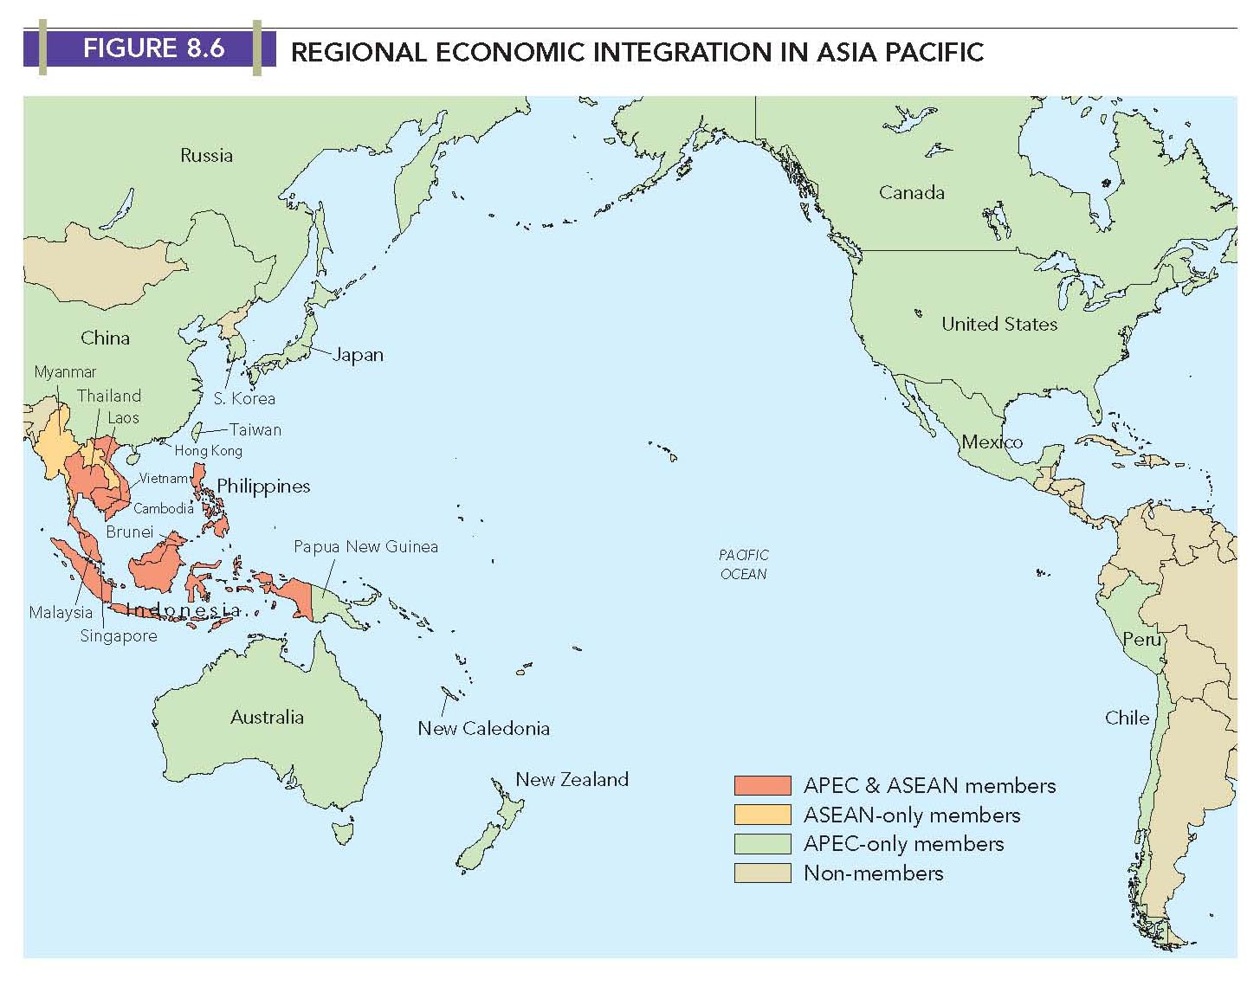
Regional Economic Integration in Asia Pacific

Slide 28
ASEAN
The Association of Southeast Asian Nations was formed in 1967 but had not been economically active until 1992.
ASEAN set up the ASEAN Free Trade Area in 1992, and intra-ASEAN trade has grown by 12% annually since then.
Intra-ASEAN trade was not big in scale since ASEAN’s main trading partners (US, EU, Japan, China) were outside the region.
In 2001, ASEAN launched an agenda of ASEAN+3(China, Japan, Korea). In 2002, ASEAN and China signed an ASEAN-China Free Trade Agreement to be launched in 2010, when ASEAN signed a free trade agreement with China to remove tariffs on 90 percent of all traded goods.
10 members: Brunei, Indonesia, Malaysia, the Philippines, Singapore, Thailand, Vietnam, Laos, Myanmar, and Cambodia.

Slide 29
APEC
Asian Pacific Economic Cooperation (APEC) was founded in 1989.
APEC currently has 21 members including the United States, Japan, China, and Korea.
APEC wants to increase multilateral cooperation (pursuing freer trade and investment, anticorruption, knowledge economy) in view of the economic rise of the Pacific nations and the growing interdependence within the region.
APEC leaders adopted the Bogor Goals in 1994, which aimed for free and open trade and investment in the Asia-Pacific by 2010 for industrialized economies and by 2020 for developing economies.
Consensus-based decisions, non-binding implementation and voluntary participation or implementation of member states
But no significant progress has yet been made. The extent of cooperation (e.g., possible FTA) remains to be seen.

Slide 30
TPP/CPTPP
Trans-Pacific Strategic Economic Partnership (TPP) started with a trade agreement between Brunei, Chile, New Zealand, and Singapore in 2005.
The TPP became a trade agreement signed by 12 Pacific Rim countries (Korea not included) that comprised 40 percent of the global economy.
Trump withdrew the US from the TPP in 2017, and the remaining TPP countries have forged ahead with a new version of the pact, known as the Comprehensive and Progressive Agreement for Trans-Pacific Partnership (CPTPP), keeping most of the original intact.
Elimination or reduction of tariffs , liberalization of services trade.
investment rules, e-commerce guidelines, intellectual property
protections, and labor and environmental standards

Slide 31
Implications for Businesses

Slide 32
Member Businesses
Advantages
- Bigger market
- Greater specialization of value-chain activities (Greater economies of scale)
- Dispersion of value-chain activities
- Improved integration of activities
- Exploitation of country differences
- Innovations & Improved competitiveness
Disadvantages
- Tougher competition
- More difficult to do business
- Thinner margin
- Greater risk

Slide 33
Non-Member Businesses
Advantages:
- Bigger market
- Greater incentive to move in & do business inside
- Once inside, enjoy all other benefits
Disadvantages:
- Barriers against them
- Tougher competition

Slide 34
Member Nations
Advantages:
- Economic cooperation and growth
- Enhanced competition
- Greater specialization of industries
- Better utilization of the resources
- Greater bargaining power of nations
- Political stability
Disadvantages:
- Erosion of national interests
- Conflict b/w national government and the central unit (e.g., EU) in terms of policies
- Conflict b/w national government and interest groups

Slide 35
Non-Member Nations
Advantages:
- Increased consumer demand/bigger market
- Political stability
- Greater incentive for FDI
Disadvantages:
- Barriers to outsiders
- Smaller bargaining power

